Slide 1
The British and Foreign Bible Society
An overview of our Strategy
Notes:
STRATEGY ANIMATION

Slide 2
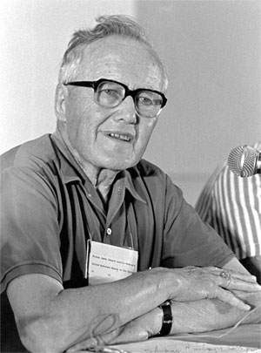
‘Western Culture is… the greatest missionary challenge of our age’
Notes:
After a lifetime of missionary work amongst Hindus and Muslims, he said…

Slide 3
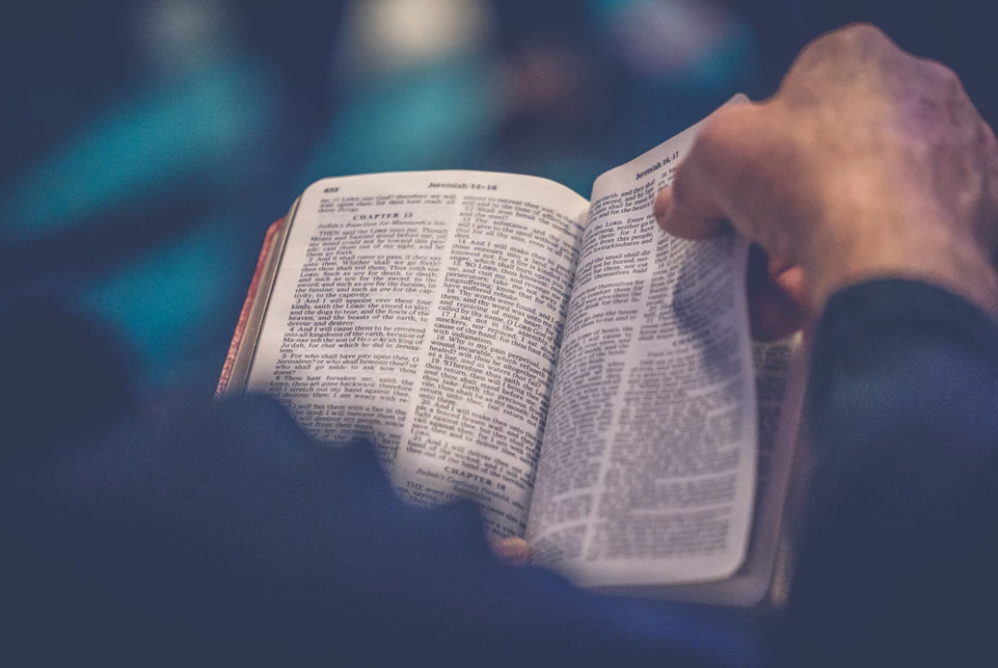
What words do people use to describe the Bible?
Notes:
When we ask …

Slide 4
Notes:
But these are the words of church-goers …

Slide 5
Notes:
Here’s how it looks when we include non church-goers …

Slide 6
Bible Society feels called to:
Increase Bible confidence in the Church.
Change the conversation about the Bible in culture.
See the transformative embodiment of the Bible in the world.

Slide 7
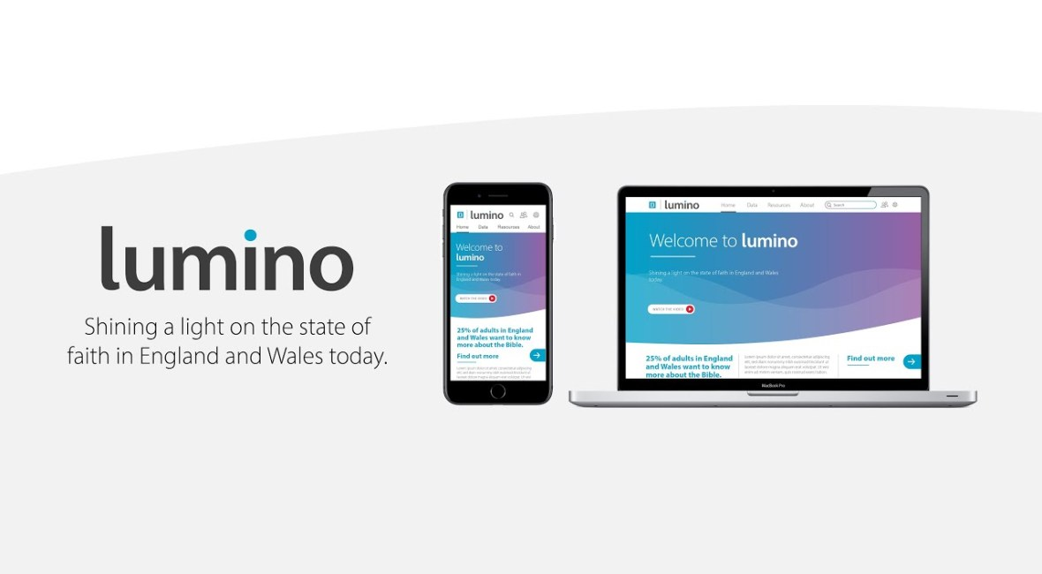
Listening to our Communities

Slide 8
Image: Alex Motoc on Unsplash
FEAR AND LAMENT IN OUR COMMUNITIES

Slide 9
ROLE FOR THE CHURCH IN CORONAVIRUS RECOVERY
What role, if any , do you think the Christian church should have in helping the UK recover from the coronavirus pandemic?
Base: 3182 adults in England and Wales

Slide 10
THE CHURCH AFTER THE PANDEMIC
Thinking about the future of the Christian Church after the coronavirus pandemic is over…to what extent do you agree or disagree with the following statements?
Base: monthly or more churchgoers N=366

Slide 11
WELCOME, GEN Z
25 per cent of them agree that in two years’ time ‘more people will be engaging with faith and spirituality’
74 per cent agree it’s important for them to try to make a difference in the world
Base: 18-24 year olds N=353

Slide 12
Supporting our Communities
Notes:
So the story of Navigating Trauma starts in 2017. Bible Society was approached by Freedom’s Ark Church in North London and the head pastor, Nims Obunge, asked us: ‘Is there anything we can do for families who have been affected by knife crime?’

Slide 13
Mobilising our Communities – Psalm 23 Banquets & Gardens

Slide 14
Mission Re-Imagined…
What does it look like to engage in mission in a post pandemic world?

Slide 15
The British and Foreign Bible Society

