Slide 1
Lambeth Palace – a London residence of the Archbishops of Canterbury since the 13th century
First and foremost it is home for the Archbishop of Canterbury and his family when in London.
Also, the Palace serves as the central office for the Archbishop’s national and international ministry.
Notes:
I had hoped someone from the Palace would give this talk about the Palace but in the absence of anyone knowledgeable, you have me instead.
For hundreds of years the Palace has been the London home of the Archbishop of Canterbury and is his central office. It is a working Palace and not a tourist attraction.
The Archbishop’s senior advisers and administrative staff are employed here, together with those who service the Palace, taking care of the historic building and its grounds.

Slide 2
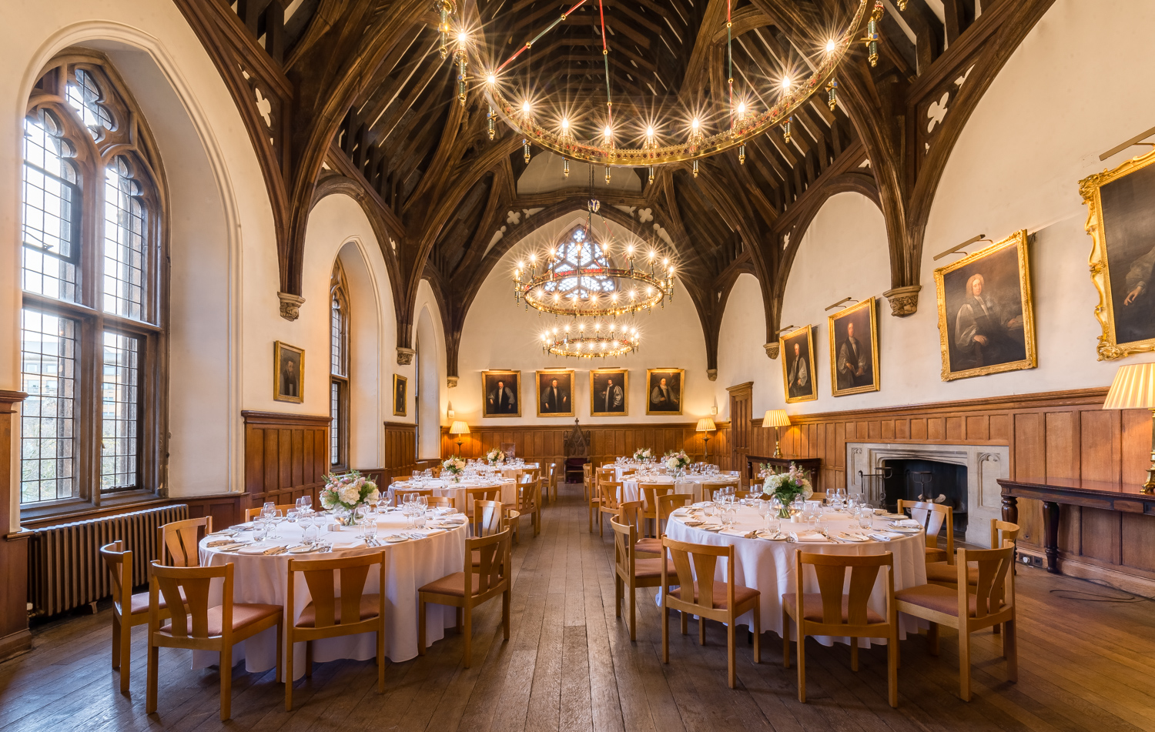
The Guard Room – derives from the time when the office of Archbishop warranted an army
This is where his armed soldiers would have gathered and where their weapons would have been stored. Although it has retained its name, the Guard Room has been used since the 19th century as a space for official entertaining.
The portraits on display are of Archbishops of Canterbury from the 17th and 18th centuries.
Notes:
The Guard Room.
The Archbishop used to have an army hence the name. In more recent times it has been used for entertaining.
Portraits of former Archbishops are on the walls.

Slide 3
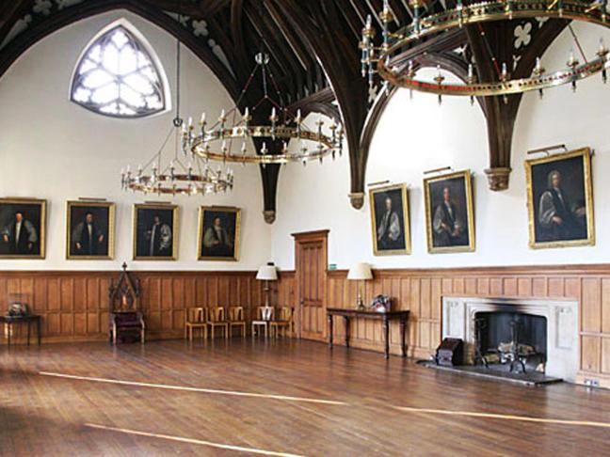
The Guard Room – used as the Great Chamber of the Palace in Medieval times
The arch-braced ceiling dates back to the 14th century when the original hall was built. The room was subsequently restored by architect Edward Blore from 1829 to 1830.
The décor has largely remained the same in this space since then.
Notes:
Some of the Palace was damaged in World War Two but the Guard Room has not changed much since it was restored in 1829.

Slide 4
Sir Thomas More and Archbishop William Laud (whose portrait is on the wall)
Notes:
It is believed that Sir Thomas More, the Chancellor to King Henry VIII, was asked to take the Oath of Supremacy in this room. The Oath of Supremacy acknowledged King Henry VIII as supreme Head of the English Church, thereby denying Papal authority. More refused and was subsequently executed at the Tower of London in 1535.
Displayed underneath the portrait of Archbishop Laud is a complete tortoise shell. The shell belonged to the pet tortoise of Archbishop Laud. Laud was the Archbishop of Canterbury during the reign of King Charles I. With the outbreak of civil war, Laud remained faithful to the King and was subsequently executed by the Parliamentarians in 1645. The tortoise is believed to have outlived his master by 120 years, happily living in the Palace Gardens. Palace legend goes that the tortoise sadly came to its end after being disturbed by a gardener whilst it was hibernating in the cold winter months.

Slide 5
Morton’s Tower
A red brick Tudor gatehouse, is the formal entrance to Lambeth Palace.
Built in 1490 by Cardinal John Morton, who lived in the tower for a short time.
Notes:
Built in 1490 by Cardinal John Morton and commonly referred to as the Gatehouse.
Morton’s Tower is also known as the Gatehouse and is staffed by a team of gatekeepers, who still lodge in the same part of the tower as when it was built.
On the ground floor in the South Tower there is a small prison cell. It was only used briefly in the 16th century, but you can still see two iron rings fixed to the wall.

Slide 6
The Crypt Chapel
It is the oldest part of Lambeth Palace.
Today the Crypt Chapel is in near constant use with services including Morning Prayer, Eucharist and Evening Prayer.
Notes:
Originally used for wine and beer storage among other things over the centuries.
It was not used as a chapel until World War Two, when the main Chapel was destroyed. William Temple also used the Crypt as an air raid shelter at the beginning of the war.
Nowadays it is used for lots of services.

Slide 7
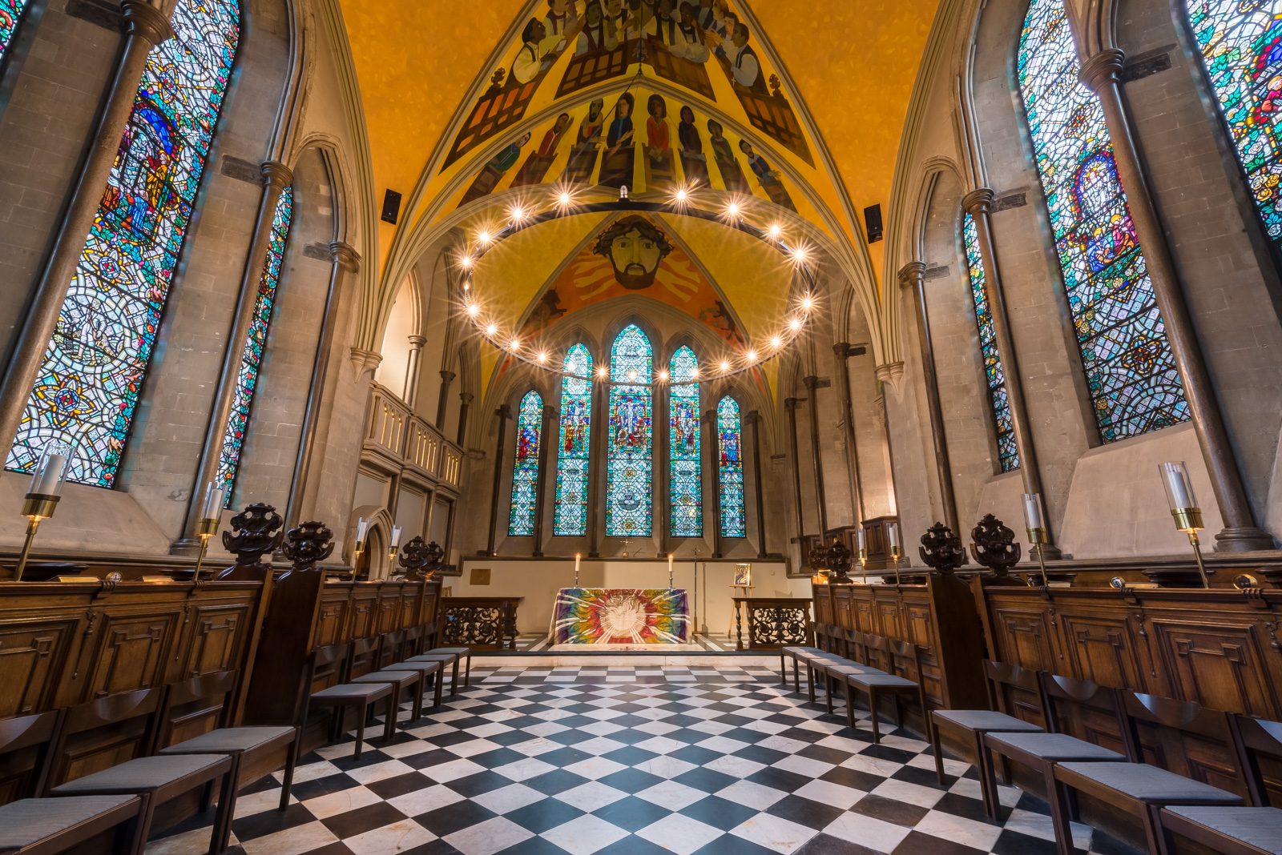
The Chapel
Since the 13th century it has been the private chapel for the Archbishop of Canterbury.
The present day ceiling artwork, ‘From Darkness to Light’ was painted by Leonard Henry Rosoman in 1988.
Notes:
Since the 13th century it has been the private chapel for the Archbishop of Canterbury. Unlike the Crypt Chapel, the main Chapel has been changed many times over the centuries.
It was badly damaged during World War Two when the roof and all the windows were destroyed by a bomb.

Slide 8
The Great Hall
Dates back to the early 13th century.
The Great Hall was demolished and rebuilt in 1660.
Destroyed again by an air raid during the Second World War.
Notes:
It dates back to the early 13th century and was often used for banquets and feasts.
In the mid 1600s [during the Civil War I imagine] the Great Hall was demolished and sold off brick by brick. Archbishop William Juxon rebuilt the Hall in 1660.
It was destroyed again by an air raid during the Second World War.
Now, it houses collections of manuscripts, books and documents for the Church of England’s history.

Slide 9
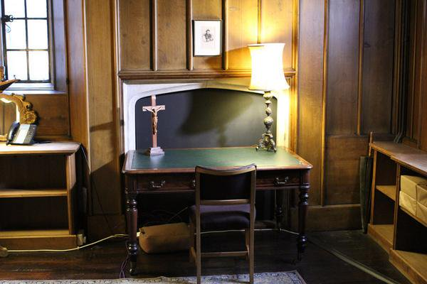
Cranmer’s Study
Behind the Chapel stands a red brick Tudor tower, built in the time of Archbishop Thomas Cranmer, who served Henry VIII.
This is the room in which we know that Cranmer studied, wrote and prayed.
Notes:
Behind the Chapel stands a red brick Tudor tower, built in the time of Archbishop Thomas Cranmer, who served Henry VIII.
Cranmer compiled the Book of Common Prayer.
This is the room in which we know that Cranmer studied, wrote and prayed. To this day it is still very much the Archbishop’s private sanctuary where he studies, writes and prays.

Slide 10
The State Drawing Room
A large part of the room was destroyed in 1944 during an air raid. In 1998 the room was restored to Edward Blore’s original design.
Notes:
The State Drawing Room used to be the Archbishops of Canterbury’s daily living room. A large part of the room was destroyed in 1944 during an air raid. In 1998 the room was restored to Edward Blore’s original design.
Today the State Drawing Room is mainly used for entertaining visiting guests, including religious and political leaders and members of the Royal Family.

Slide 11
Lollards’ Prison or Lollards’ Tower
The grey stone tower was built in the 15th century in the time of Archbishop Chichele, and is known as the Lollards’ Tower.
At the top of a long spiral staircase and behind two iron-studded oak doors, is a small unlit cell in which 'Lollards' were allegedly imprisoned.
Notes:
The grey stone tower between the chapel and the river was built in the 15th century in the time of Archbishop Henry Chichele, and is known as the Lollards’ Tower.
At the top of a long spiral staircase and behind two iron-studded oak doors, is a small unlit cell in which 'Lollards' were allegedly imprisoned.
Anyone know who the 'Lollards‘ were? They were followers of John Wycliffe who, as you may be aware, advocated translation of the Bible into the native language – a tradition that we follow to this day.
It may also have been used as a prison during the Civil War, when Lambeth Palace was in the hands of the Parliamentarians.
Although it was badly burnt in the Blitz during the Second World War, it is still possible to decipher the initials of unfortunate prisoners carved into the old oak panels.

Slide 12
The Fig Tree (White Marseille)
The Fig tree is located on the west side of the courtyard, and came to Lambeth Palace with the last Roman Catholic Archbishop, Cardinal Reginald Pole, in 1556.
The tree was relocated to this position in 1828 when Edward Blore built the residential block, and it bears abundant fruit every autumn.
Notes:
My colleague Nigel tells me this is the tree where Adam and Eve secured their first attire … I’m not convinced ☺
On the west side of the courtyard is a magnificent White Marseille fig tree, which came to Lambeth Palace with the last Roman Catholic Archbishop, Cardinal Reginald Pole, in 1556. He served Mary I (Mary Tudor) until they both died on the same day 17 November 1558. The tree was relocated to this position in 1828 when Edward Blore built the residential block, and it bears abundant fruit every autumn.

