Slide 1
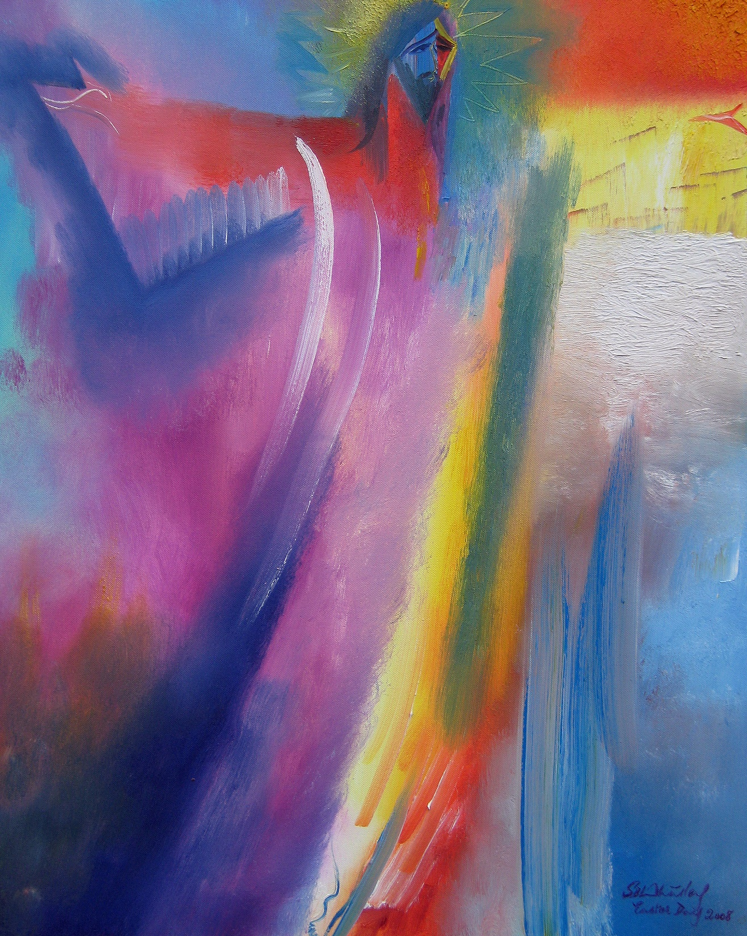
OUR EASTER JOURNEY The Painters’ Path: Palm Sunday to Pentecost
Notes:
The Painter’s Path: Palm Sunday to Pentecost
While we’re in the Easter season I want to take you on a visual journey as we prepare for Jesus’ Ascension and Pentecost.

Slide 2
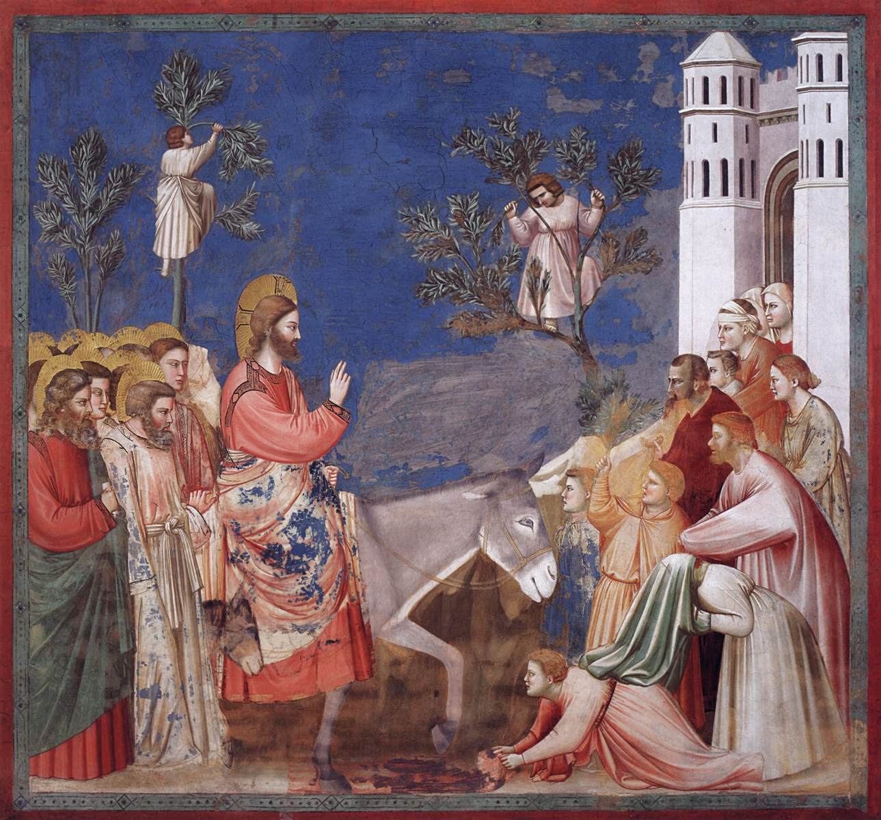
Palm Sunday
The Entry into Jerusalem. Giotto. c.1304–06. Fresco. Scrovegni (Arena) Chapel, Padua, Italy.
Matthew 21.1–11.
Notes:
We start with PALM SUNDAY and with the Italian artist Giotto.
Jesus has been travelling from Galilee to Jerusalem – teaching, healing and preparing his disciples for what lies ahead. Here in Giotto’s painting, Jesus rides with dignity towards his crucifixion for the sake of our salvation.
The artist has placed Jesus in the centre of this fresco with the disciples crammed together on the left, their golden haloes vying for attention. They are curious and unsettled, cautious and wary. Jesus has prepared them for his arrest and death, but they are still afraid, afraid of the unknown. How will it all end?
The people on the right are very different as they flow out of the city of Jerusalem. We see both men and women, their faces are more visible – they’re keen to meet Jesus – they’re hopeful and joyful at what he promises. While this unusual procession is taking place, two eager people are in the top trees picking palm branches to honour Jesus. You can almost see the branches about to sway with their weight. The man in the tree on the right holds his arms in a crucified position foretelling Jesus’ fate.
The azure blue sky offers us warmth and definition while at the bottom right, one man rolls out his cloak in a royal gesture – the red-carpet treatment. Two other chaps above him are still getting their cloaks off to follow suit. Notice how Giotto includes not just the magnificent donkey but the endearing little colt hidden in plain sight. If you listen well, you can almost hear the crowds shouting, ‘Hosanna to the Son of David! Hosanna in the highest heaven!’ For Matthew’s Gospel and his Jewish readers these terms would hold historical and theological significance, since this crowd understands that Jesus is the promised King.
Jesus looks almost three-dimensional in this picture, and while he is the Messiah, in riding on a donkey, we see his nature and his invitation to us all: ‘The Son of Man comes not to be served but to serve.’ Christ’s blessing with two fingers pointing upwards symbolises both his humanity and his divinity. Soon, he will be the subject of lies and ridicule, desertion by his friends, senseless violence and brutal death, yet Jesus’ focus is not on himself. He offers peace and blessing along his path.
See how the donkey takes centre stage, stepping forward boldly and obediently mirroring Jesus as the faithful servant of God. This donkey is focused which we see in her confident stride. She is fully aware of what is going on. With one ear pointing backward and one pointing forward, she’s attuned to her master and to the crowd. She is a bridge between what is past and what lies ahead in the salvation story.

Slide 3
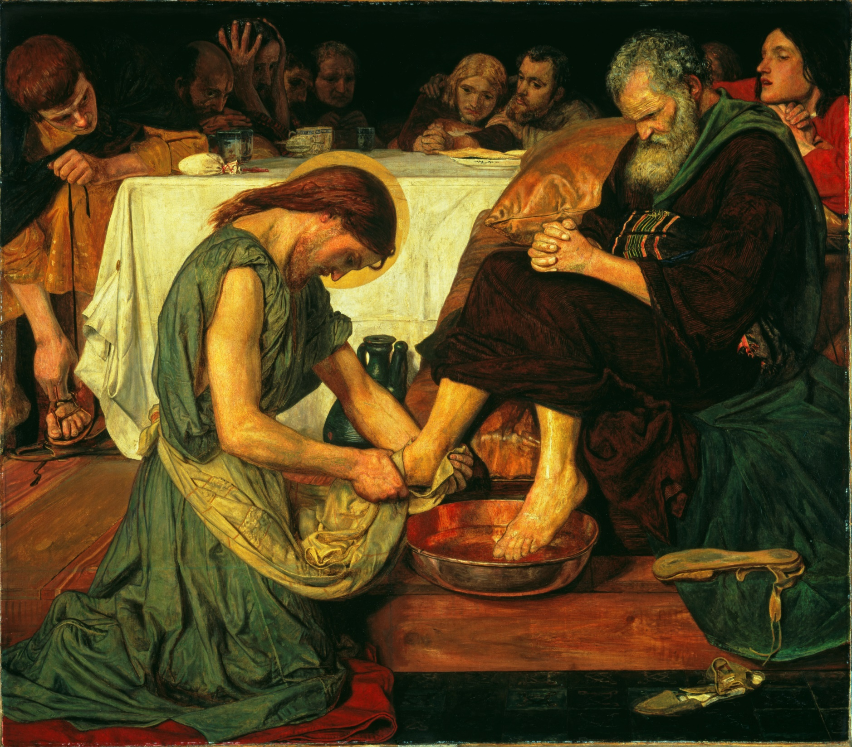
Maundy Thursday
Jesus Washing Peter’s Feet. Ford Madox Brown.
1852–6. Tate Britain
John 13.1–38.
Notes:
MAUNDY THURSDAY
With such a low viewpoint and intimate space, we’re not simply observing this painting – we’re invited into this room to be with Jesus and the disciples.
Shortly after Jesus and his friends had celebrated the Passover, Jesus rose from the table and began washing their feet. In Jewish and Roman custom, this was a most demeaning task, and therefore, was usually done by a household slave. For Jesus, the Son of God, to wash smelly, human feet was nothing short of a scandal. Just look at the disciples’ expressions around the table.
Then Jesus calmly laid aside his outer garment. As he lays aside his clothes, so he lays aside his divinity to wash those whom he loved. And he would have his clothes forcefully removed from him when he laid down his life on the cross. He would himself, lay his clothes neatly aside in the tomb, as he rose from the dead. Jesus tells Peter that there’s a spiritual significance to this simple task that Peter won’t understand until ‘later’ – that we all sin, and we cannot clean ourselves, and we only need to be washed once in this way. Perhaps this is a nod towards baptism. Jesus is insistent. The disciples cannot have real fellowship with him unless he washes their feet.
Is Peter terrified? Who wants to follow a God who does this kind of thing? Peter’s ‘never’ – ‘You will never wash my feet…’ in Greek is an emphatic no – as in ‘never in my lifetime’, rather than a polite, ‘No thank you Jesus, not today if you don’t mind awfully’. Since whose feet would he, Peter, now have to clean? Perhaps, as Peter addresses Jesus three times, twice as ‘Lord’ and once as ‘you’, Peter knows he will doubt Jesus at the end, will deny him three times. So this is a warning of what he cannot fulfil. Or maybe, by letting Jesus wash his feet, it’s just too much to bear. It’s better to remain at a safe psychological distance. Or is Peter sad for Jesus, that his Lord and master is humiliating himself with this task? Is it a loving plea to retain some dignity and divinity here? Yet, while Jesus, in his grasshopper green robe, calmly continues washing Peter’s feet, a storm is brewing in Peter’s head. See those frown marks, Peter's awkward, intense concentration, his clenched hands.
This Gospel story reverses our obsession with ourselves and forces us to bend low (quite literally) to anyone we meet. If Jesus, our Saviour, will wash feet, what can stop us too? Jesus washes all of his disciples’ feet, including those of Judas. Judas is seated on the far left – lacing up his sandals. His feet have been washed already, while his white moneybag lies on the edge of the table securing Jesus’ imminent death. Jesus doesn’t deprioritise those who betray him and make Judas wait to the end. Jesus’ love is unconditional towards everyone.
In contrast, John the beloved disciple sits on the far right looking over Peter’s shoulder. This painting caused an absolute outcry when first exhibited since Jesus was bare-chested and the Victorians thought this was a scandal to show Jesus half naked and in a domestic setting; and the artist was forced to paint clothes back on Jesus before the painting would sell. Ford Madox Brown wanted to portray Jesus as a manual labourer, entirely associated with the working class, the class that the Victorians most despised yet most needed in the Industrial Revolution. A hypocrisy similar to that of many Pharisees with their strict protocols in public and in private. Yet Jesus reverses all of their rules and in so doing redeems us all.

Slide 4
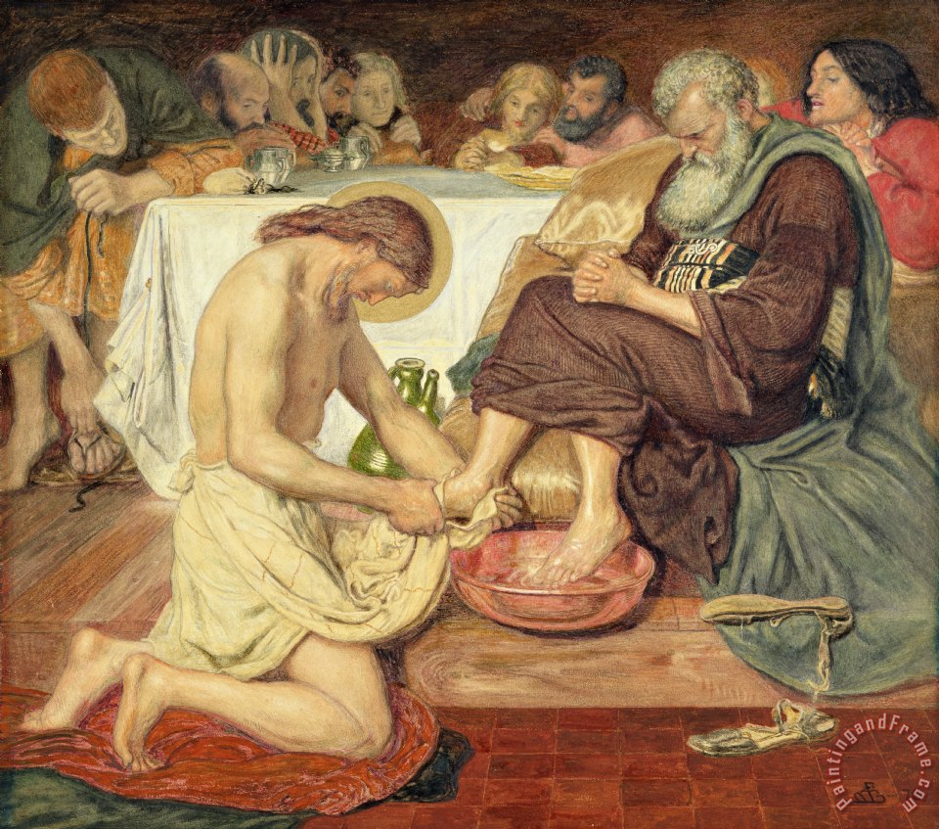
Maundy Thursday
Jesus Washing Peter’s Feet. Ford Madox Brown.
Original version

Slide 5
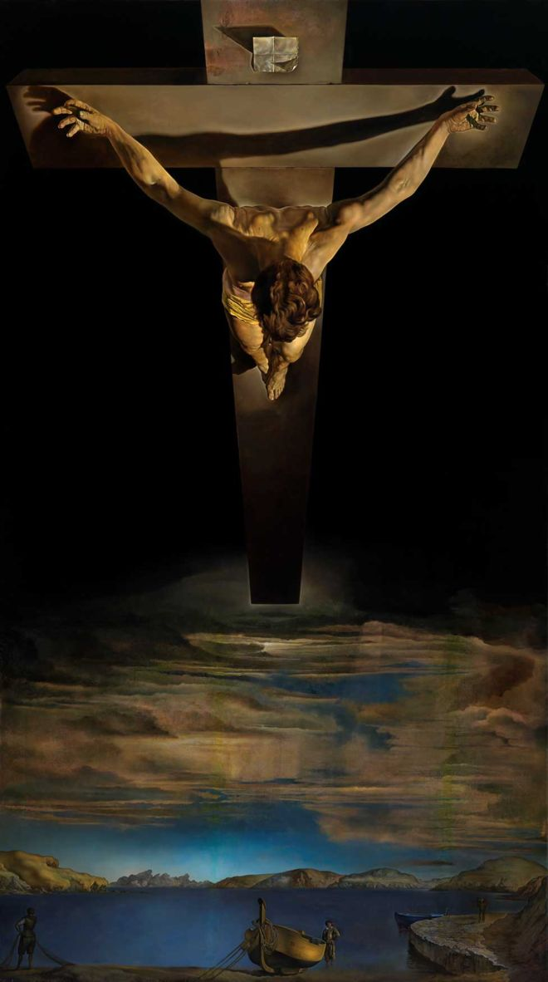
Good Friday
Christ of St John of the Cross. Salvador Dali.
1951. Kelvingrove Art Gallery & Museum, Glasgow.
John 18.1—19.42.
Notes:
GOOD FRIDAY
This painting is in direct contrast to our previous one, with its high viewpoint and perspective, portrayed from above the earth, looking down. It is the heavenly perspective that only God can see, and is still the most-viewed painting of the crucifixion in the world.
Christ of St John of the Cross is a painting by the Surrealist Salvador Dali. It depicts Jesus on the cross in a darkened sky, hanging over a body of water complete with a boat and fisherman at the bottom left. Although it is clearly the crucifixion, it has none of the usual elements. There are no nails in Jesus’ hands and feet, no blood seeping from his side, and no crown of thorns around his head.
Dali was inspired to paint this scene by a crucifixion sketch that the Spanish Carmelite and mystic, St John of the Cross, drew in 1550; and by a dream he had of Christ in his perfect form from an unusual angle. The composition of Christ was based on a triangle and circle. The triangle is formed by Christ's arms and points down towards his feet; the circle is formed by Christ's head. This triangle symbolises the Trinity, and the circle in Platonic thought, represents ideal unity. The combination presents us with perfect harmony.
In order to recreate the figure of Christ realistically, Dali arranged for the Hollywood stuntman Russell Saunders to hang from an overhead gantry. Dali was able to see how the body would appear from the desired angle, and to envisage the precise pull of gravity on the human body. No artist had portrayed Christ in this way previously. It offers us a unique visual understanding about Christ’s death: that he perfected his divinity in his humanity. The water below is the Spanish bay where Dali lived yet also represents new life. Cleansed by Christ’s death and resurrection this lake becomes a sign of baptism. The boat moored in the front reminds us of Jesus calling the disciples to be fishers of men. The mountains in the background refer to the countries that Jesus commanded the disciples to go and preach in.
Jesus is outstretched, outcast, outlived but not outdone. Here we see in motion, that Christ’s paschal mystery unites the human with the divine. And Dali invites us to be caught up into the divine, as our eyes travel up and down the canvas.

Slide 6
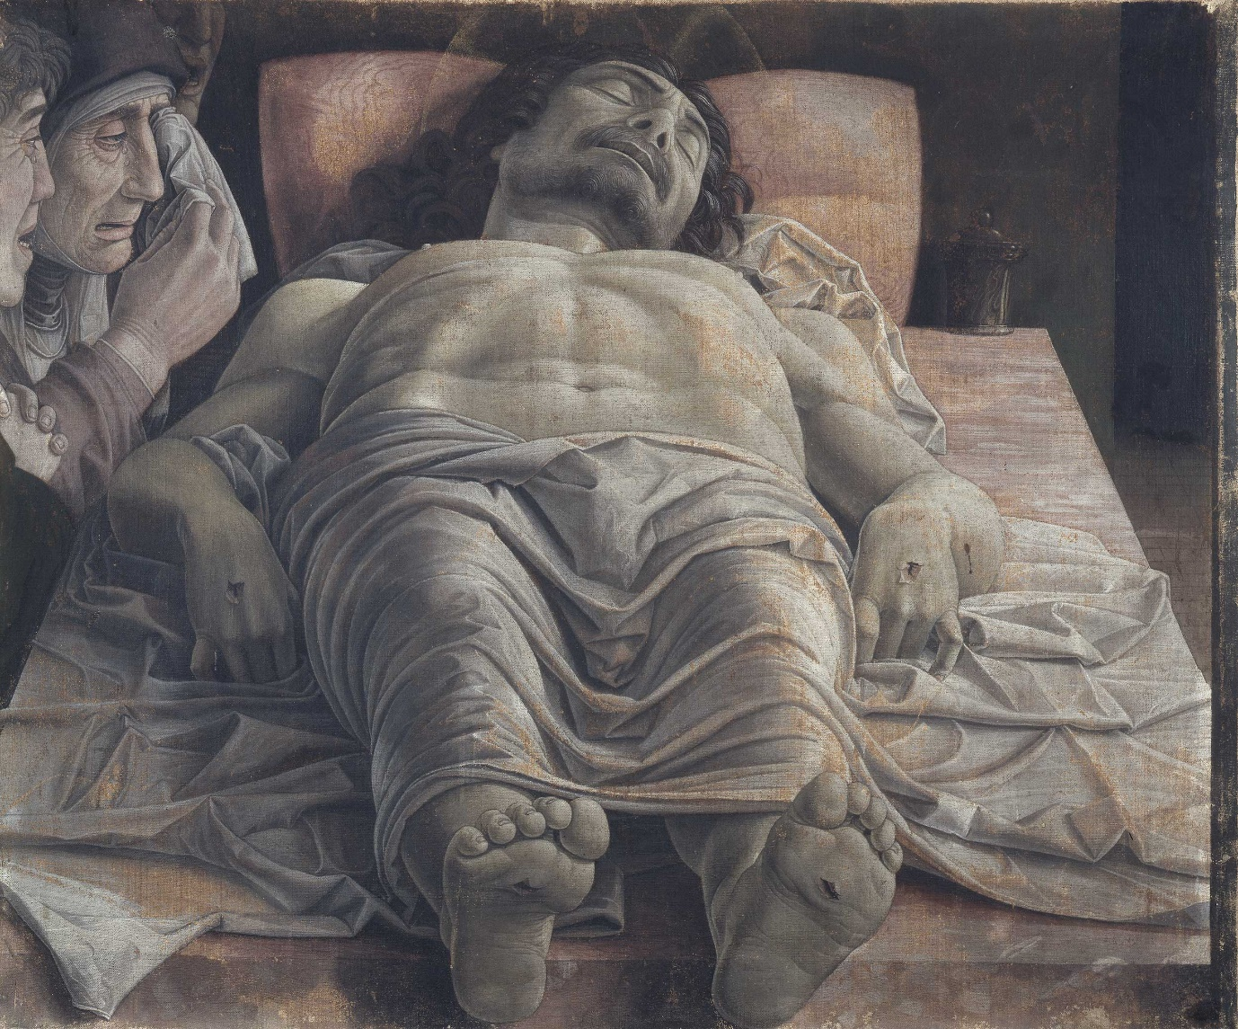
Holy Saturday
Lamentation over the Dead Christ.
Andrea Mantegna.
c.1483. Pinacoteca di Brera, Milan.
Mark 15.42–47.
Notes:
HOLY SATURDAY
Holy Saturday is the day in the Christian calendar that celebrates the 40-hour-long vigil that the followers of Jesus Christ held after his death and burial on Good Friday, and before his resurrection on Easter Sunday. According to the Bible, Jesus' followers and family held a vigil for him outside his tomb, awaiting his foretold resurrection. Biblical references to this vigil are short, but accounts of Jesus’ burial are in all four gospels.
Here we have another extraordinary viewpoint and perspective on Christ’s passion, watched over by his mother Mary, St John the beloved disciple, and St Mary Magdalene mourning Jesus’ death. Mantegna’s dramatic foreshortening evokes an immediate emotional impact because he draws our eyes directly to Christ’s body without any warnings or barriers. Mantegna’s skill in recreating this scene in such forensic detail is outstanding, as he takes us on a journey around a dead body at rest. Christ’s grey skin and shroud seem to emerge from the marble slab beneath his supine body, and yet remain unyielding with rigor mortis. Just look at the toes on Christ’s right foot coupled with those awkward wrists and bent fingers.
The longer we linger over this painting, the more fascinated we are by this illusion of perspective and pallor. We cannot help but hover over Christ’s body, his muscular frame and open wounds, his thorax rising in front of his chin, and his curls of hair adding to the endless folds and ripples of our emotions. Yet on closer inspection, as if in a mortuary, we see that Christ’s feet are too small and hanging over the edge of the slab. He has more work to do. Mantegna deliberately reduced the size of Jesus’ feet so that they would not obscure our access to his face. Likewise, he ensures that the chief mourners in being held to one side, are not the only people to share in this grief.
In medieval and Renaissance art, lamentation was a common theme, but this interpretation is much more unusual and macabre. In most versions there is more physical contact between the mourners and the body, which instantly shifts the focus onto human loss rather than divine rest. This painting is not peaceful. It does not hold back on realism, or grief, or stark simplicity (the only other object in the room is a jar of embalming ointment. Pathos is the palette of this artist. Mantegna ensures that we cannot forget the death of Christ.

Slide 7
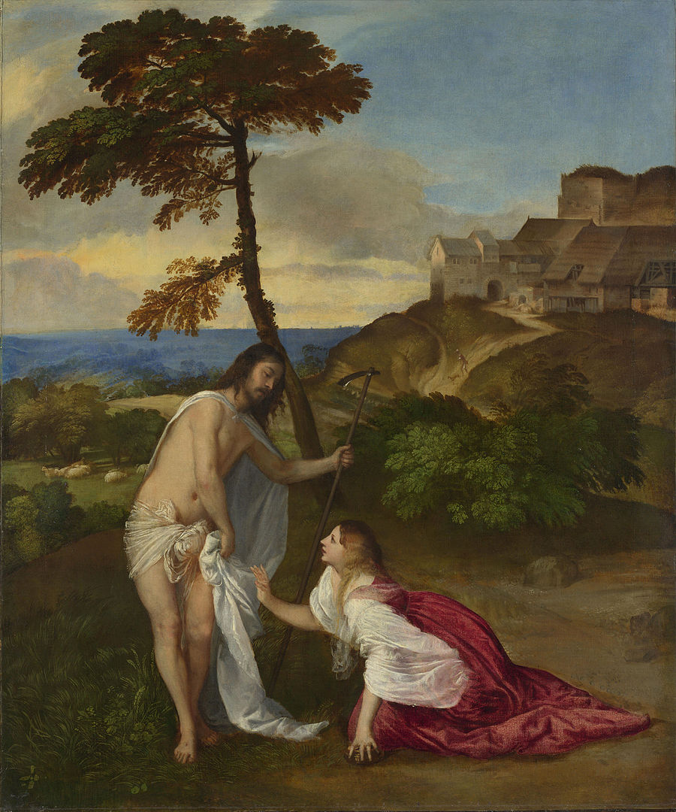
Easter Sunday
Resurrection (Noli Me Tangere).
Titian.
c.1514. National Gallery, London.
John 20.1–18.
Notes:
EASTER SUNDAY
Titian paints Christ as Mary Magdalene saw him. We are looking at Jesus through the eyes of faith. This encounter is as much about love as it is about landscape.
Here is Jesus risen from the dead, explaining to Mary Magdalene what has happened to him and why she cannot touch him. The title Noli me tangere in English ‘Do not touch me’ (or sometimes translated as do not ‘hold’ or ‘cling’ to me), comes from John 20.17. Jesus says that he’s still travelling to his Father but before he ascends, he has an important request to make in this garden. He’s about to commission Mary Magdalene to bring the Good News to the apostles. She is to be the apostle to the apostles.
Mary Magdalene has been waiting for Jesus and when told by two angels that he’s no longer in the tomb, she begins her search. To say that she is awestruck when she meets someone she believes to be a gardener is an understatement. This gardener complete with hoe, and originally, a rustic hat, turns out to be Christ himself. Instinctively Mary Magdalene wants to touch him to see if he is real. In this moment, she bridges the divide between earth and heaven. Kneeling in her carnal red clothing, left hand still clutching the alabaster jar but focusing entirely on Jesus’ face, Mary Magdalene learns a new type of love.
For Titian, art was a multi-sensory experience so this painting about the act of ‘not touching’ combines the biblical role of the characters with the artist’s role of revelation. Christ and Mary Magdalene each bring to life what others cannot see – love and faith, transformation and renewal. Now Christ is busy, but he’s not in a hurry. Soon, he will ascend to heaven and prepare the way to send the Holy Spirit to his followers, and he does not want them to cling to his physical presence. Behind Christ is a flock of sheep, a reminder of his followers then and now. So, Christ is just passing by. Mary Magdalene leans towards him diagonally, but her closeness to the ground shows that she is still rooted in the physical world. Christ, in contrast, is standing in front of the tree, symbolising his closeness to heaven. These two figures provide harmony and balance: Mary Magdalene's body is an arc and the line of her body continues up into the tree. The arc of Christ's body flows over into the curve of the rocks to our right: their contours meet in the middle. This meeting point is the grace of revelation.

Slide 8
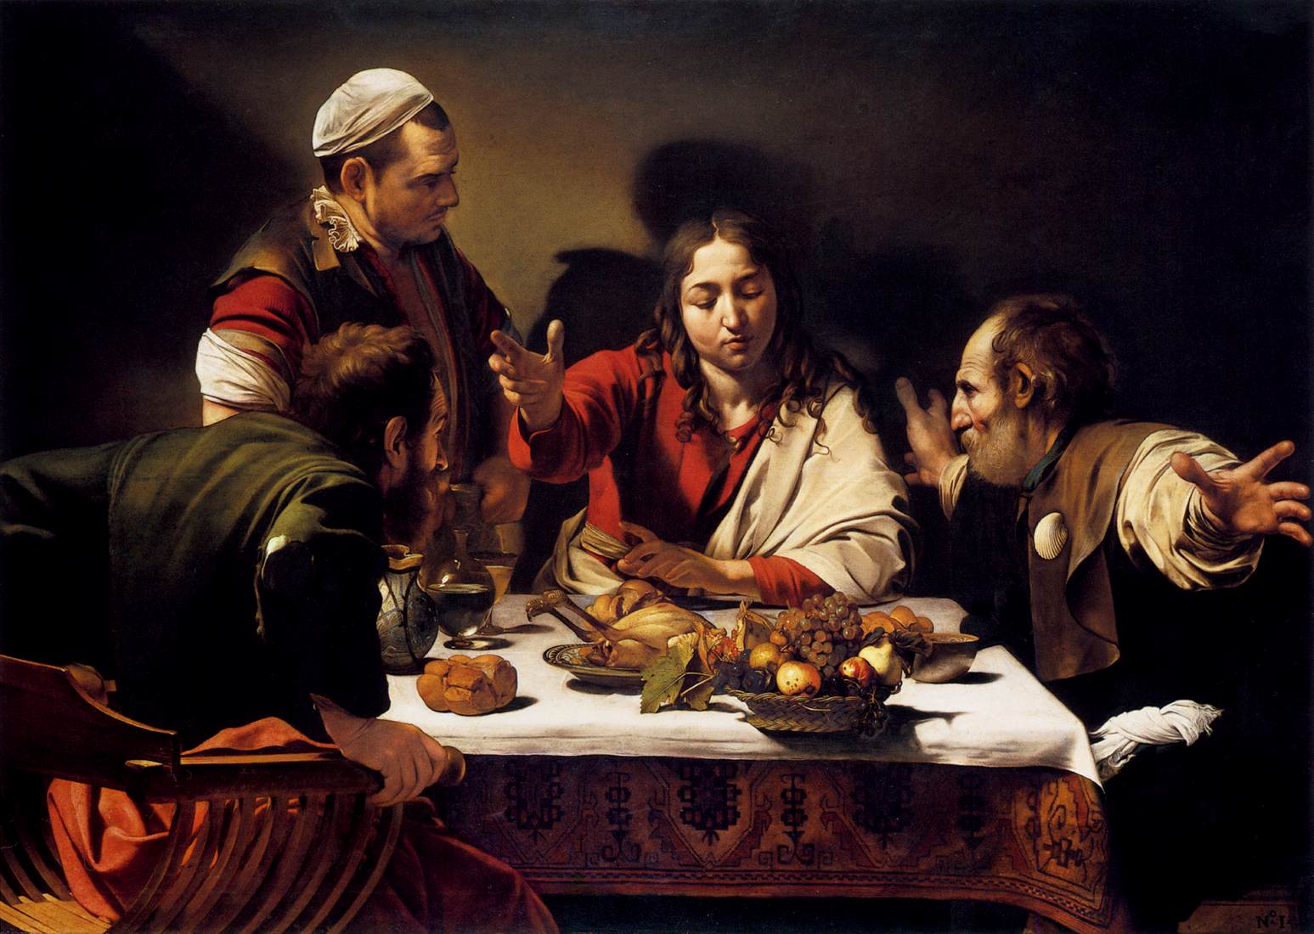
Easter Monday
The Supper at Emmaus.
Caravaggio.
1601. National Gallery,
London.
Luke 24.13–35.
Notes:
EASTER MONDAY
Since it is only in the fellowship meal that Christ reveals himself both physically and spiritually, this painting becomes timeless. Any viewer or believer in any age is welcome to the table of Christ. Caravaggio is offering us the gift of salvation.
Caravaggio follows Luke’s description of a Greek symposium meal, in which the artist places Christ at the centre and the disciples on either side. Caravaggio created a large space between the two disciples that enables us to see and relate to Christ directly, rather than via the disciples. This allows us to participate in this symbolic meal. The disciple on Jesus’ right is Cleopas and an unnamed disciple on his left wears the pilgrim’s symbolic scallop shell. The disciples were not on a pilgrimage, because pilgrimages only became popular from the 4th century. Caravaggio probably saw the symbol as part of the Counter-Reformation revivals in mediaeval religious devotion.
Despite the absence of candles we see colours range from the darkest to the lightest through the skill of shifting abruptly between one tone and another. This chiaroscuro technique ensures that the light is at the service of the whole picture and therefore, the whole meaning. This scene feels deceptively real, rather than imagined. Its tension and force lie in the illusion that we are participators in this miraculous event. From the varied gestures and the torn jacket sleeve united in their emergence from the painting, to the symbolic fruit bowl about to topple over, Caravaggio shows us the difference between telling and showing.
Caravaggio does not depict Christ with obvious credentials except that of his red and white cloak, symbolising the triumphant resurrection. We cannot see any nail marks in his hands, nor a wound in his side, or any facial features that would distinguish him from his companions. He is recognised in his gesture alone. The innkeeper is bewildered. He does not recognise the blessing symbol or understand the disciples’ reactions. Does he represent the faithless who fail to recognise this Messiah, hence not removing his cap?
Caravaggio’s bread is already broken, unlike in the Luke 24.30 text. This Jesus is focused more on the blessing, as if to prolong the sublime gesture and to heighten the divine intervention. The disciples are understandably overcome, shown by having one disciple grasping the sides of his Savonarola chair while the other counterbalances this with outstretched arms bridging darkness and light, our world and the picture’s. This disciple’s arms may symbolise further, the shape of the cross. So, might he be Peter who was also crucified? Caravaggio is reminding us that the Christian sacramental meal occurs because of Christ’s crucifixion. Caravaggio is demonstrating that time is inclusive. Here, the breaking of the bread, its blessing, the disciples’ reaction and the cross symbol are happening simultaneously on the canvas. These disciples are the conductors of this astonishing revelation.

Slide 9
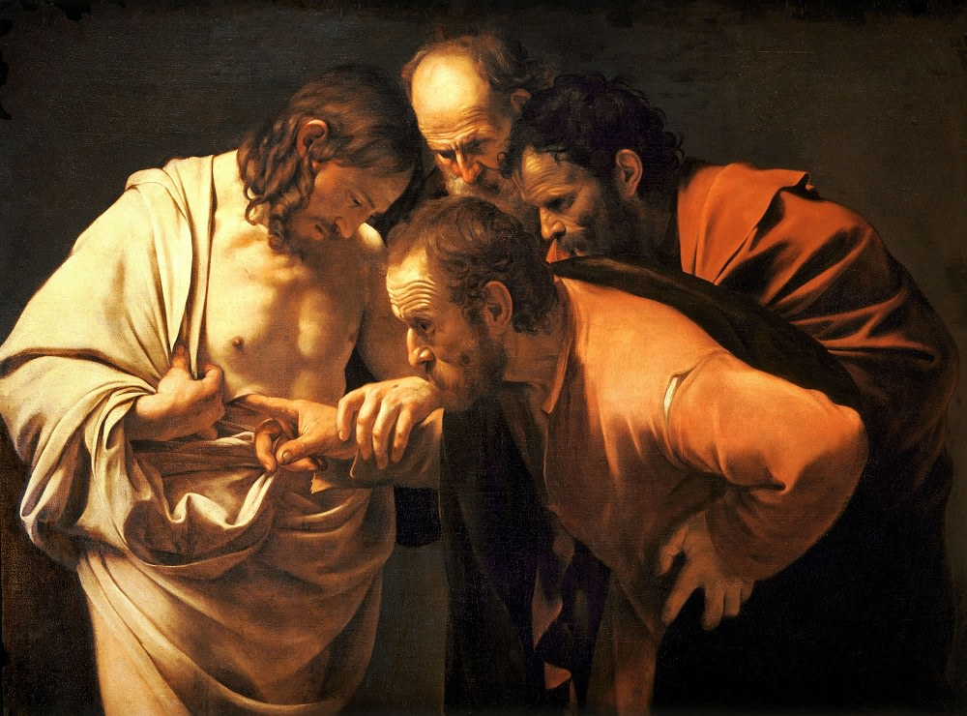
Sunday after the Resurrection
The Incredulity of St. Thomas.
Caravaggio.
1601-02. Sanssouci, Potsdam, Germany.
John 20.24–29.
Notes:
SUNDAY AFTER THE RESURRECTION
Here, as in the last painting, Christ doesn’t have a halo. Caravaggio does this to emphasise his humanity, not his divinity as the risen Lord. All the post-resurrection experiences with Christ were real, visible, and accessible through the bodily senses. Christ is not a spirit or ghost, but a complete human being who meets, greets, talks, walks, fishes, eats and blesses people after he has died. Caravaggio's skill lies in making this a reality. Look at Christ’s anatomical perfection compared with the disciples’ bulk; the elaborate folds of Christ’s shrouded garment (birth and death in one body); watch out for the ripped seam on Thomas's faded clothes; his dirty fingernails to stress his poverty and Christ’s empathy with the poor.
Look at the disciple crouching to our right in sacrificial red - it’s John, the beloved disciple. Caravaggio knew that John would be interested in seeing the wound in Jesus’ side. It is near Jesus’ chest where John had lovingly placed his head at the last supper in John 13. Now see the Gothic archway shape formed by the outline of the four figures compacted into a tenebristic background. The disciple at the head of this cluster is St. Peter. He’s at the top because he became head of the Church. We also see that the top of Christ's head is largely in shadow, since he is the person who is least knowable to us humans, the viewers.
Within the shadows of Christ’s face, Caravaggio has tucked Jesus’s hair behind his ear so that we also can see his face, and we see Christ gazing at his own body. It’s very rare in art to see a painting where Jesus is looking at himself. This is a moment of self-revelation on Christ’s part and of revelation of self on the disciples’ part. We weren’t there, but we can be sure from this painting and its supporting text, that the resurrection was, and is, real.
To want to see Jesus again is not about doubt, as Thomas has, consistently been accused, but about relationship. Thomas only asked for what the other disciples had already experienced. When it came to it, in John’s Gospel, he didn’t actually need to touch Jesus. He only does this here, so that we know which disciple he is. Thomas’ declaration of faith is unique. No other disciple in any of the Gospels expresses their faith in Christ with the same weight. When Simon Peter says ‘You are the Messiah, the Son of the living God’, it isn’t the same as Thomas saying ‘My Lord and my God’. This is more radical, more personal and it connects the beginning of John’s Gospel with its end because ‘The Word became flesh and dwelt amongst us’ happens again right now.
It‘s no accident that there are far fewer paintings of the resurrection than of the crucifixion, since the Gospels barely describe the resurrection in any detail, they just say it happened.
Is it any wonder therefore, that here the disciples’ have appalling manners, gawping at Jesus without restraint or sense of decorum. They’re in no hurry to leave, or to let Jesus get on with his busy week, because quite simply, the resurrection is no ordinary event.

Slide 10
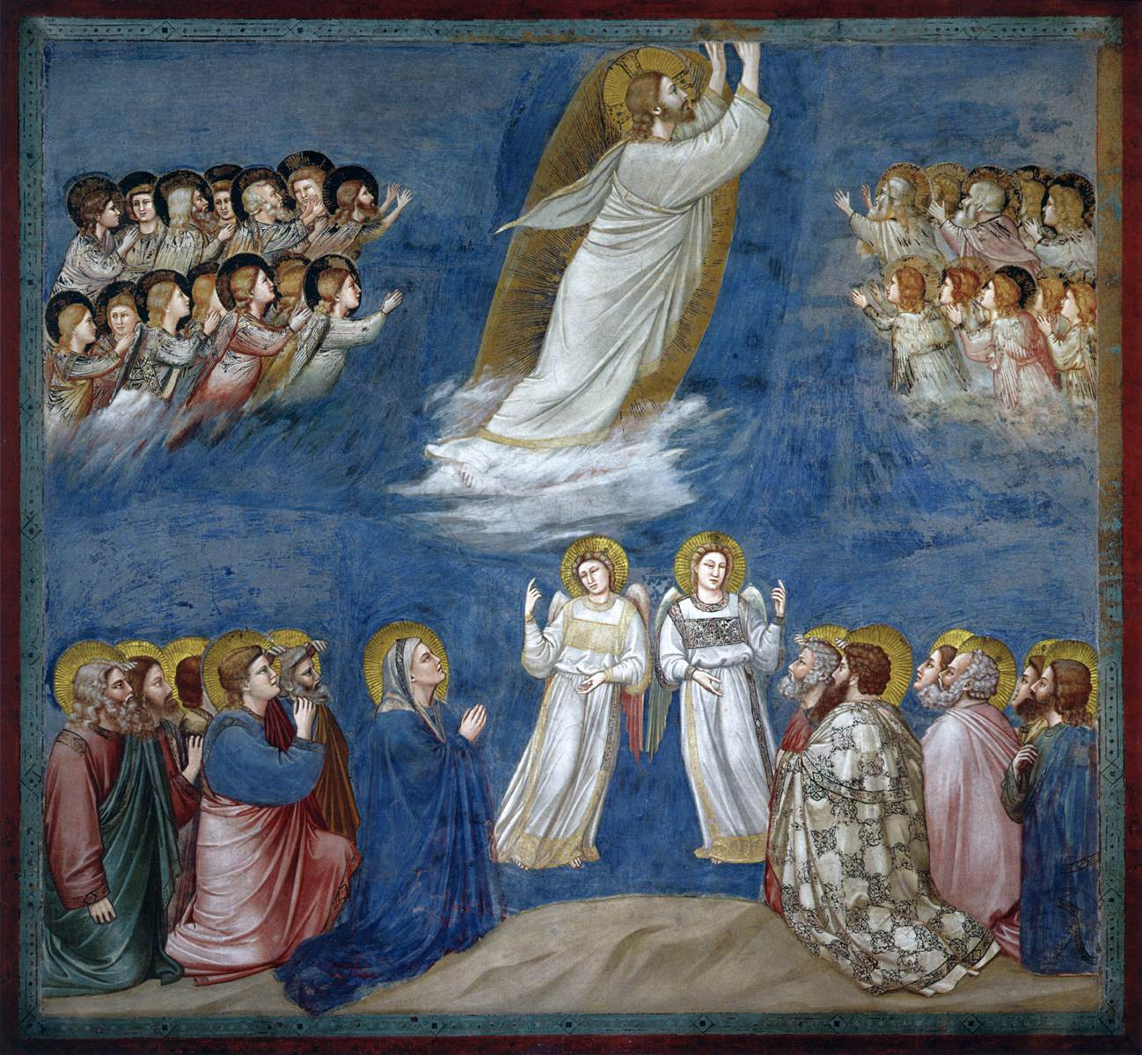
Ascension Day
Giotto.
The Ascension of Christ. c.1304–06. Fresco. Scrovegni (Arena) Chapel, Padua, Italy.
Acts 1.8–11.
Notes:
ASCENSION DAY According to Luke, when Jesus was lifted up, a cloud took him out of their sight (Acts 1.9) which is what we see here.
Two visible things with their roots in the Old Testament: a) ‘he was lifted up’ (which is elevation and praise) b) ‘a cloud took him’ (which is entrance into the divine mystery)
The fresco cycle of which this Ascension scene is a part, painted by Giotto in the Scrovegni Chapel, Padua, presents a narrative of the Life of Mary and Christ. And the cycle includes our earlier Palm Sunday painting.
Giotto was an early Renaissance storyteller and artist at the time in which perspective had yet to be mastered in a two dimensional format, yet he still manages to create depth. Neither had a person’s mood nor their characteristics been portrayed in paint accurately. So here, Giotto shows Christ in profile, reaching up towards heaven. Look how his hands are piercing through the top of the frame to encourage us to watch his movement – this is ascension in motion. We cannot contain Jesus while he is travelling.
Giotto adapts the iconographic mandorla – this is the almond shape frame around Jesus. It is much bigger than a halo as it usually surrounds the whole body rather than just the head. Unlike many mandorlas in art, there are no angels surrounding this one. Instead, the angels praise Jesus from a social distance! Some of the angels in the top left hand corner are chatting to each other – but what are they saying? And what about the two full length angels in the bottom centre, each have one hand pointing down and the other hand pointing up. By mirroring each other they convey both Christ’s humanity and his divinity with their hands, as well as the ultimate truth that the risen Lord can only return to earth if he first goes to heaven.
Below all the angels, two groups of the apostles kneel with Mary who is dressed in blue on our left. There are only 11 apostles because it is not until later in Acts 1 that they choose a twelfth to replace Judas. As they watch Jesus taken up to heaven on a brilliant cloud, some apostles raise their hands to protect their eyes from the divine light. This is exactly what we’d do in the presence of such a blinding vision. However, Mary holds her hands lower in prayer, being the nearest to Jesus and as his mother, she doesn’t need shielding from his light.
This is a painting of rapture – in seeing Christ, our gaze is utterly focused on him and where he is ascending. Our eyes follow these first believers’ eyes; they are both the eyes of those who have witnessed Christ’s resurrected body and his journey back to God. This is faith through both an old and a new lens.

Slide 11
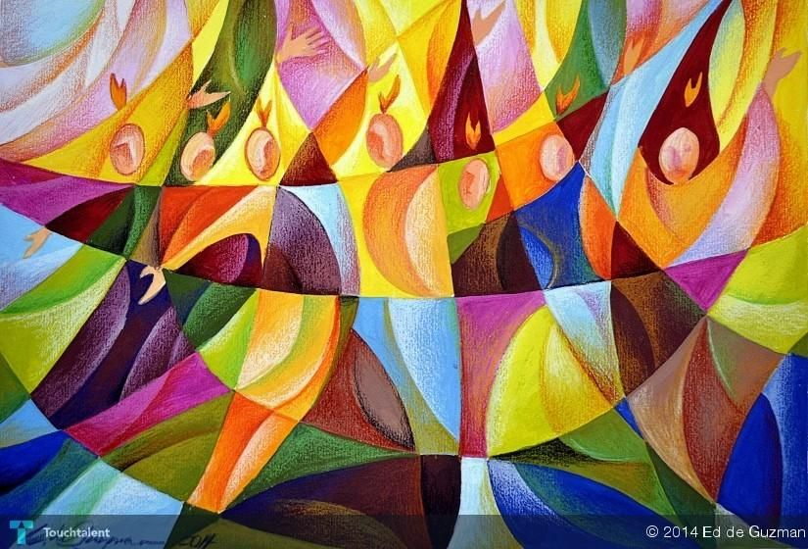
Pentecost
Edgardo de Guzman.
2014.
Private Collection
Acts 2.1–13
Notes:
PENTECOST Pentecost was an event, but the actual experience was transcendental, making an abstract depiction of Pentecost very compelling to an artist, which we see here. Jesus could have eaten his last supper on his own and the Spirit could have descended upon the disciples when they were alone. While there are times when the Holy Spirit touches us as individuals, the fact that Jesus and the Holy Spirit gathered the believers is not incidental. It underpins the centrality of the Church in God’s work in the world.
Pentecost is the new covenant between Christians and Jesus that fulfils the old Mosaic Covenant at Mount Sinai. It reveals a similar theophany in the form of wind and fire, and is the New Testament resolution of the Tower of Babel story in Genesis.
Jesus needed to send the Holy Spirit because his own disciples could not understand his teachings or read the signs he predicted while still with them. So how on earth would they cope when he was gone? This dove from above that dive-bombed into their lives at Pentecost has remained with all believers ever since. Not as tongues of fire or anything visible, but then dove-tailing is a delicate business. To dove-tail into our inner lives, we need to accept the Spirit into the depths of our hearts rather than just above our heads.
This wonderful modern painting by the artist Edgardo de Guzman creates the sense of energy and inspiration that we can only imagine must have been experienced by the apostles and those early believers in Acts 2.1–13. The Spirit blows where it will. In this painting, the Spirit is dynamic because it has this complete freedom.
While it is quite easy to see the odd hand, and flame of fire on seven heads, if you look carefully amid the colours and shapes, you can detect a dove transposed onto the central interlocking sections. It is dancing and flying because how can this bird keep still? Guzman has conveyed the movement of the Spirit as it breathes into the life and hearts of the apostles. With very few straight lines to pin the Holy Spirit down – what we see are curves and arcs in counterpoise and balance.
This artist’s palette flickers and wavers between a sunrise of yellows and oranges, pinks and burgundies, blues and greens, maroons and browns, but very few reds. In spite of this colour-fest, there is an ordered structure to this picture. The Holy Spirit is both flying and rooted.
Pentecost is a feast of great hope as well as an insurance policy for our slowness and hesitancy. The new law of Christ is written today, not on cold tablets of stone, but is engraved in our hearts. This law is the law of love and grace. This Pentecost, may we travel anew with the Spirit, no matter how daring or fiery the journey.

