Slide 1
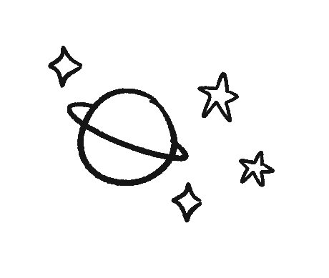
ALL GOOD!
#Genesis1 #UltimateArtist
ORIGINS

Slide 2
WELL GOOD
#Genesis2 #ImageBearers
ORIGINS

Slide 3
NOT GOOD!
#Genesis3
ORIGINS

Slide 4
ONLY NOAH GOOD
#Noah #Genesis9
ORIGINS

Slide 5
BABEL BABBLER
#YouWhat?
ORIGINS

Slide 6
SERPENT CRUSHER
#Genesis3.15
ORIGINS

